Slide 1
Use of NHANES Data to Link Pesticide Exposures to Bone Mineral Density
Ryan Bontrager, Kyle McCrocklin, Shresht Venkatraman

Slide 2
Our Research Question
Is there a significant association between pesticide urine-biomarkers and averaged Spine-Femur Bone Mineral Density
Understanding the environmental factors that may influence bone mineral density to help with preventing other related diseases

Slide 3
Bone Mineral Density (BMD)
Indicator of skeletal health
Low BMD is associated with other medical condition and risks
Osteoporosis
Increased fracture rates

Slide 4
NHANES Data
BMD and pesticide exposure collected during the 2005–2006 and 2007–2008 survey cycles
Limit to adults aged 20+
Final record count of 1927

Slide 5
Key Predictor variables
Demographic variables
Gender
Age
Ethnicity
Family poverty income ratio
Biomarker variables
2,5-dichlorophenol (µg/L)
2,4-dichlorophenol (µg/L)
2,4,5-trichlorophenol (µg/L)
2,4,6-trichlorophenol (µg/L)
O-phenylphenol (µg/L)
Environmental factor variables
Use of insect control products in home
Use of weed-killing products
Laboratory Variables
urinary creatinine levels (mg/dL)
red blood cell count (million cells/µL)

Slide 6
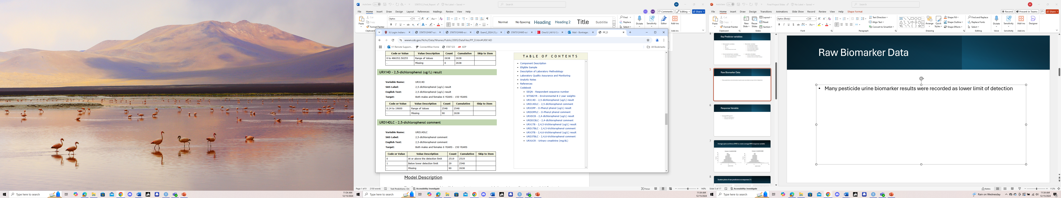
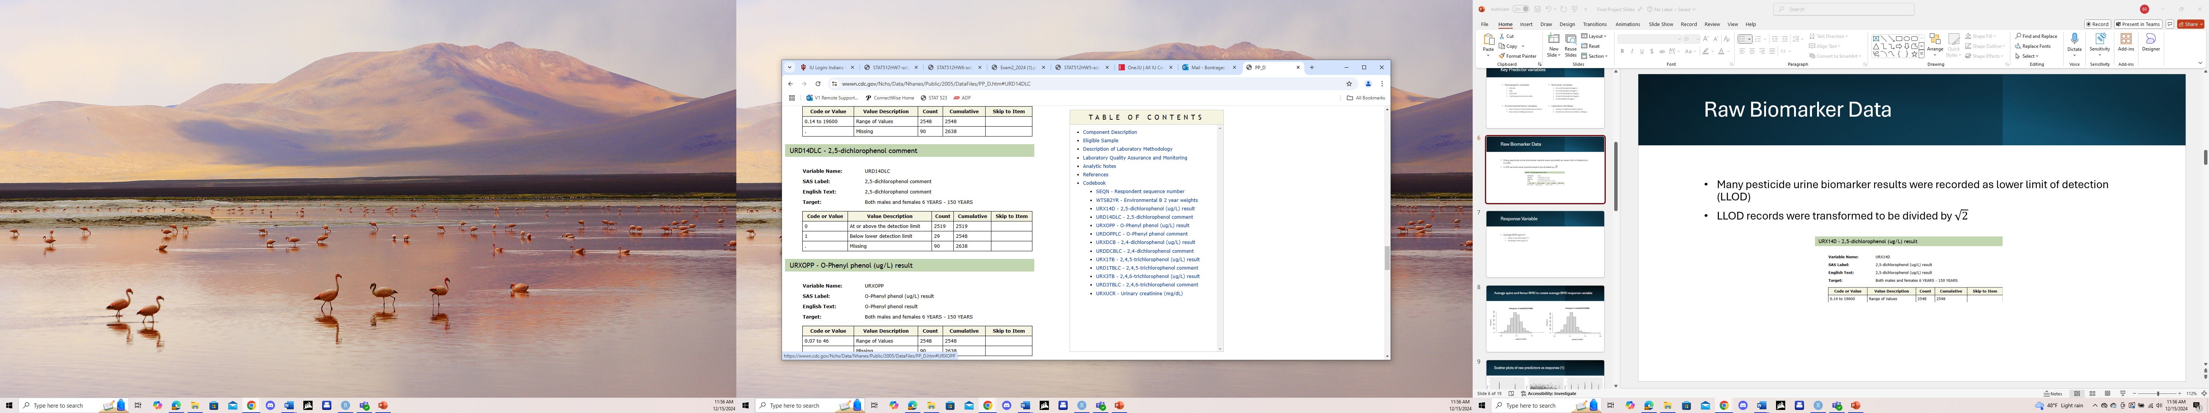
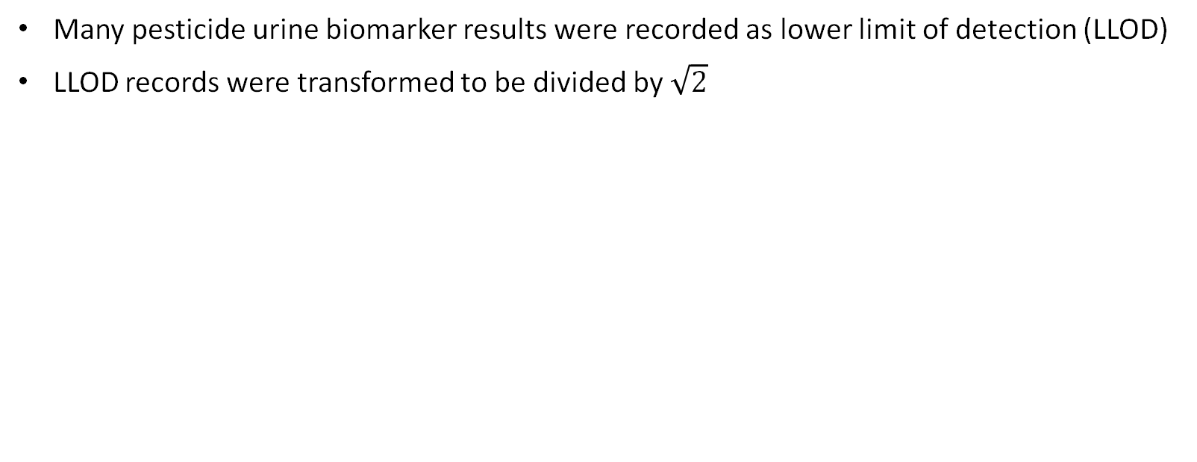
Raw Biomarker Data
Many pesticide urine biomarker results were recorded as lower limit of detection (LLOD)
LLOD records were transformed to be divided by $\sqrt{2}$

Slide 7
Response Variable
Average BMD (g/cm²)
Total Femur BMD (g/cm²)
Total Spine BMD (g/cm²)

Slide 8
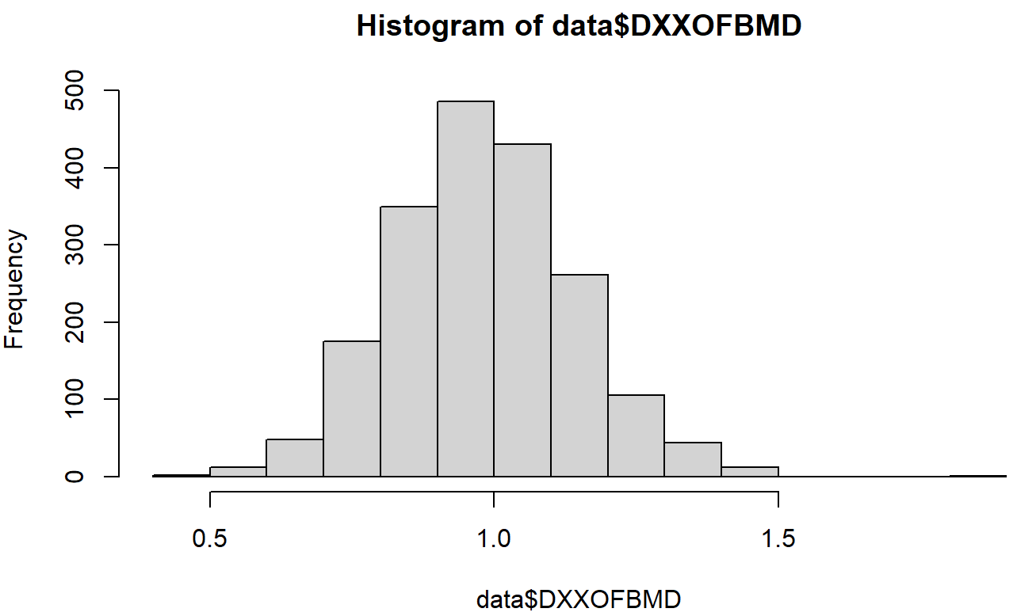
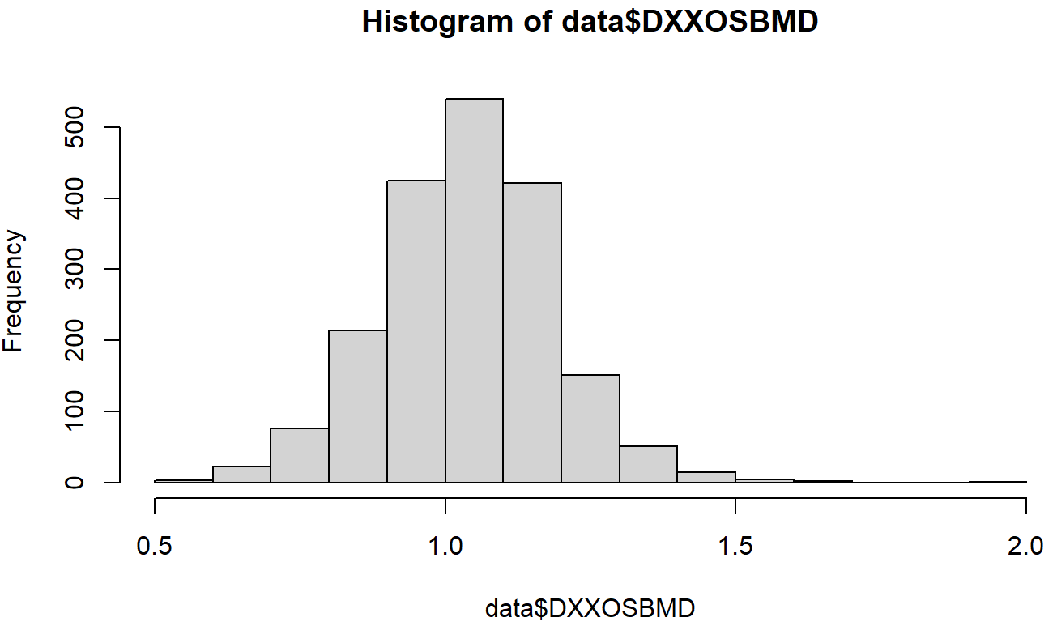
Average spine and femur BMD to create average BMD response variable

Slide 9
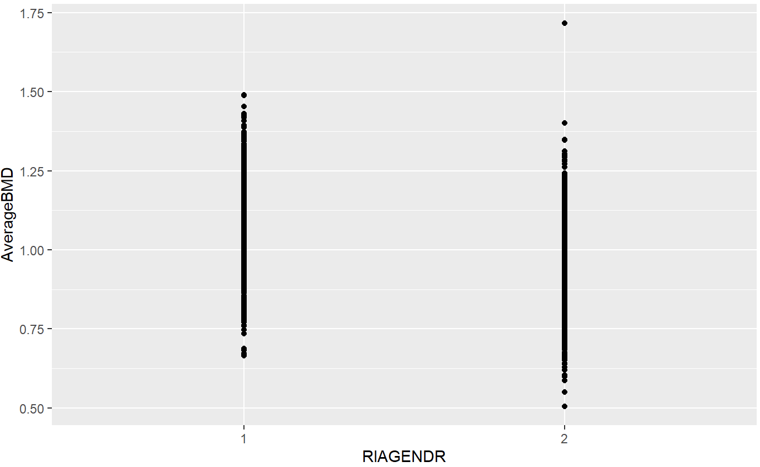
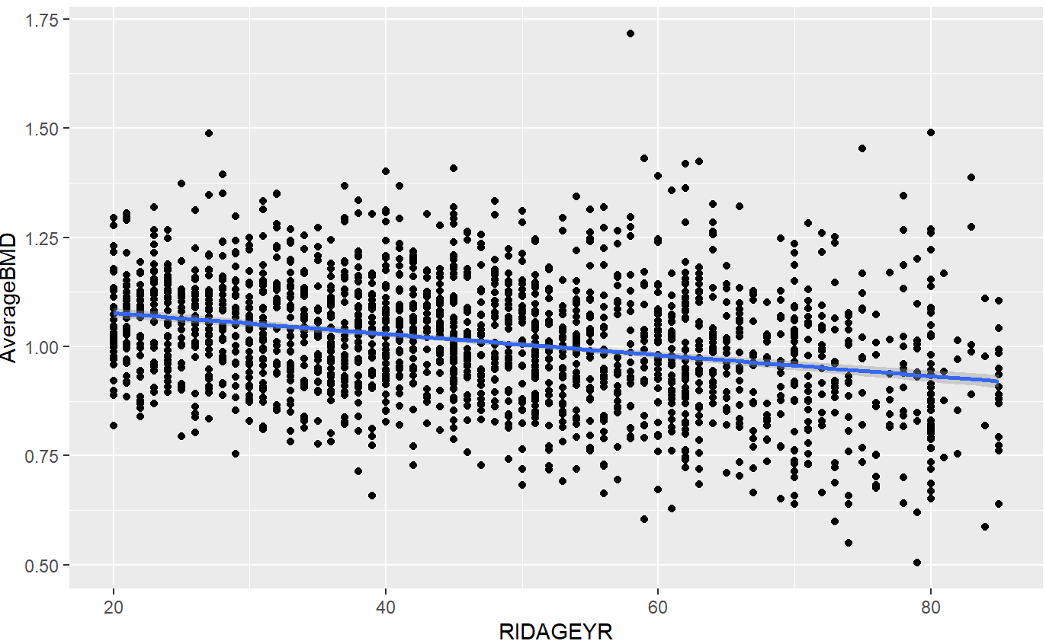
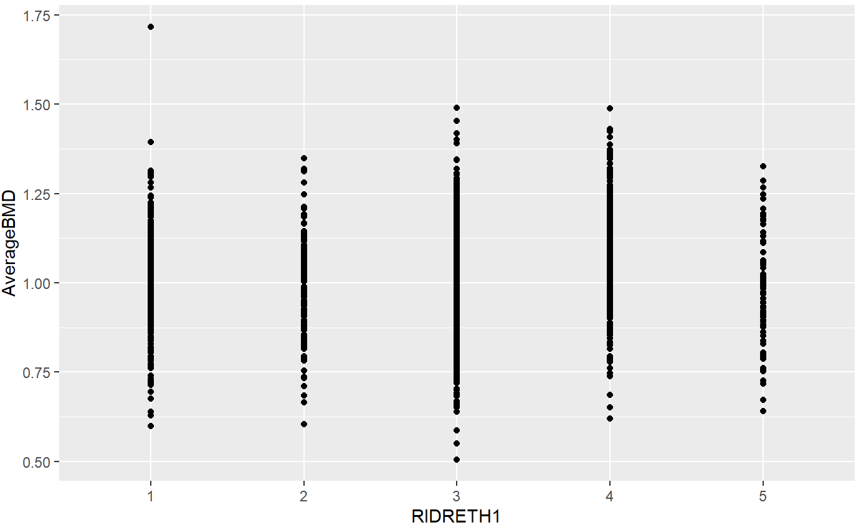
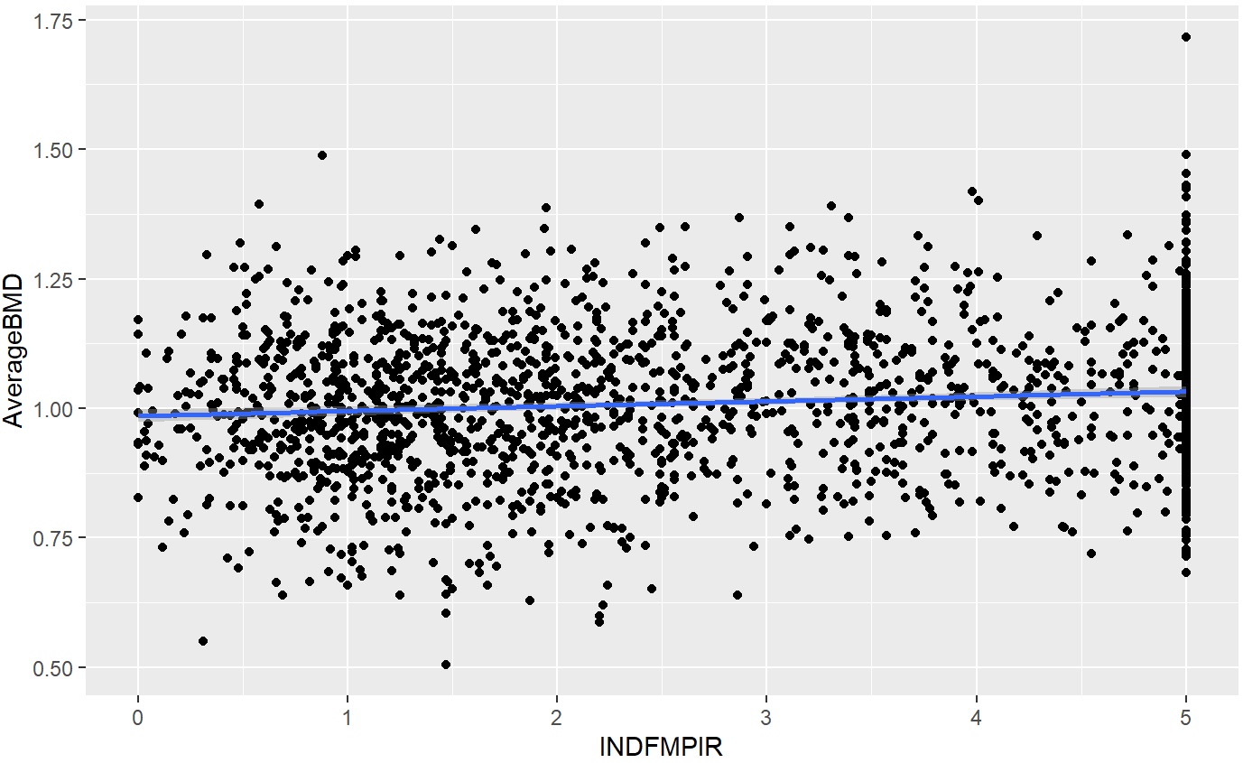
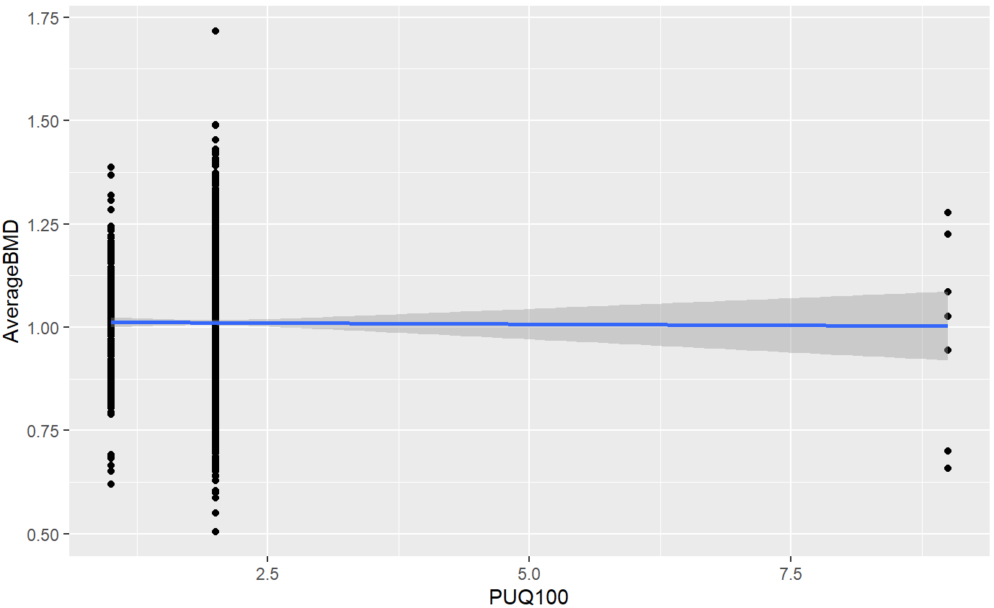
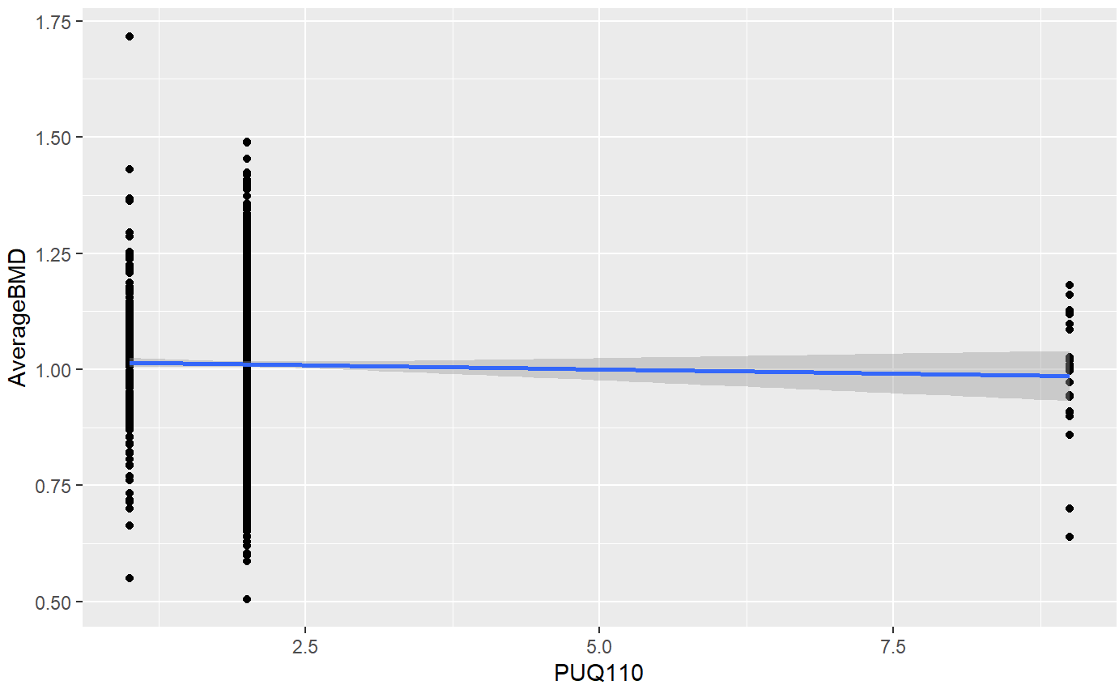
Scatter plots of raw predictors vs response (1)

Slide 10
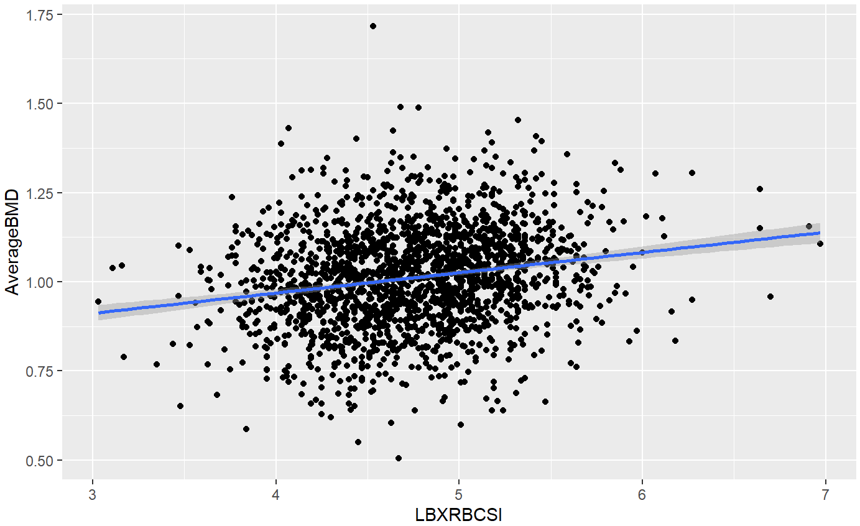
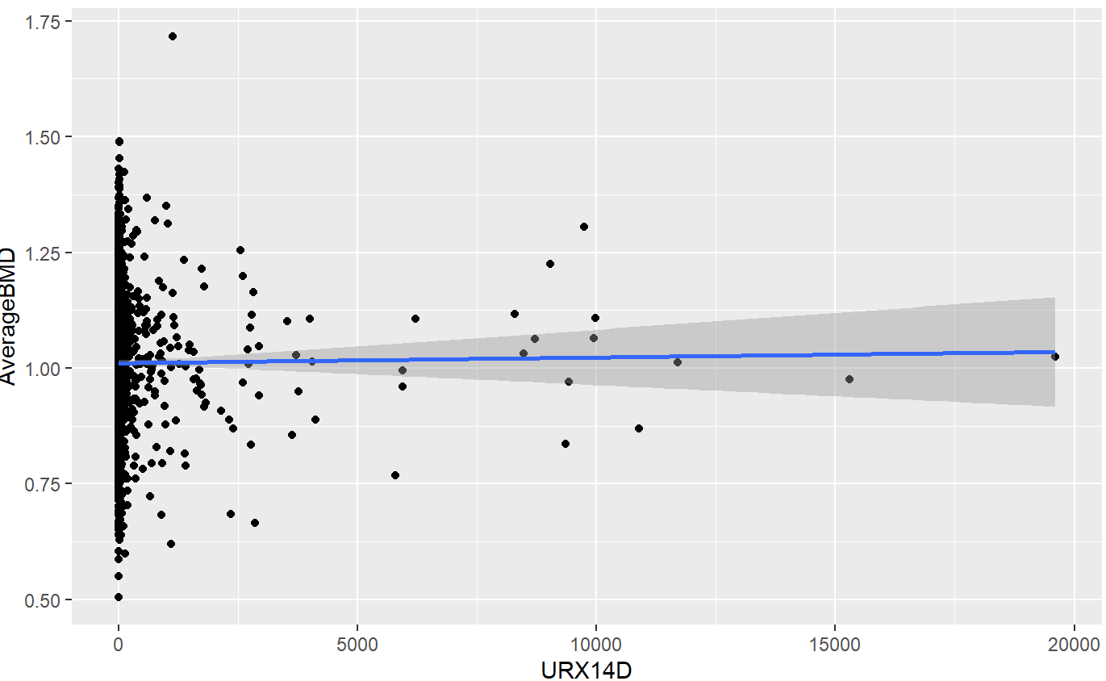
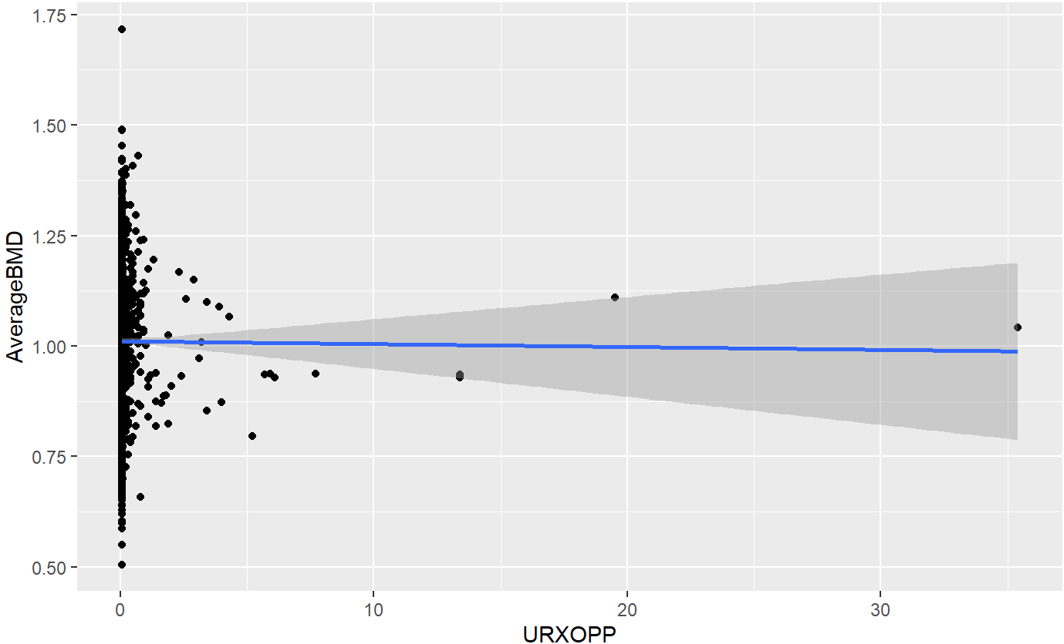
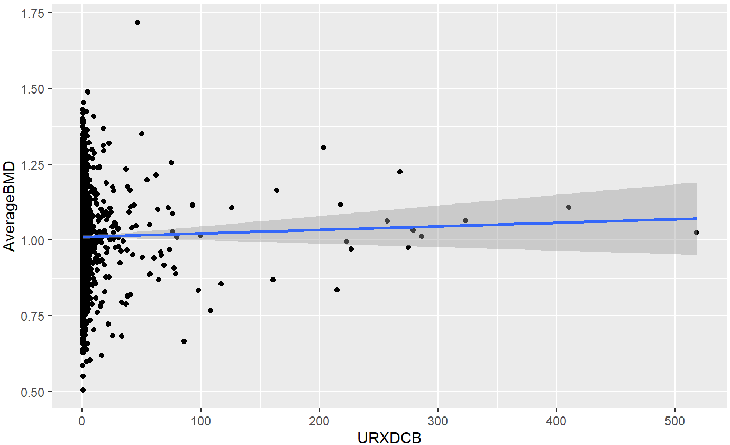
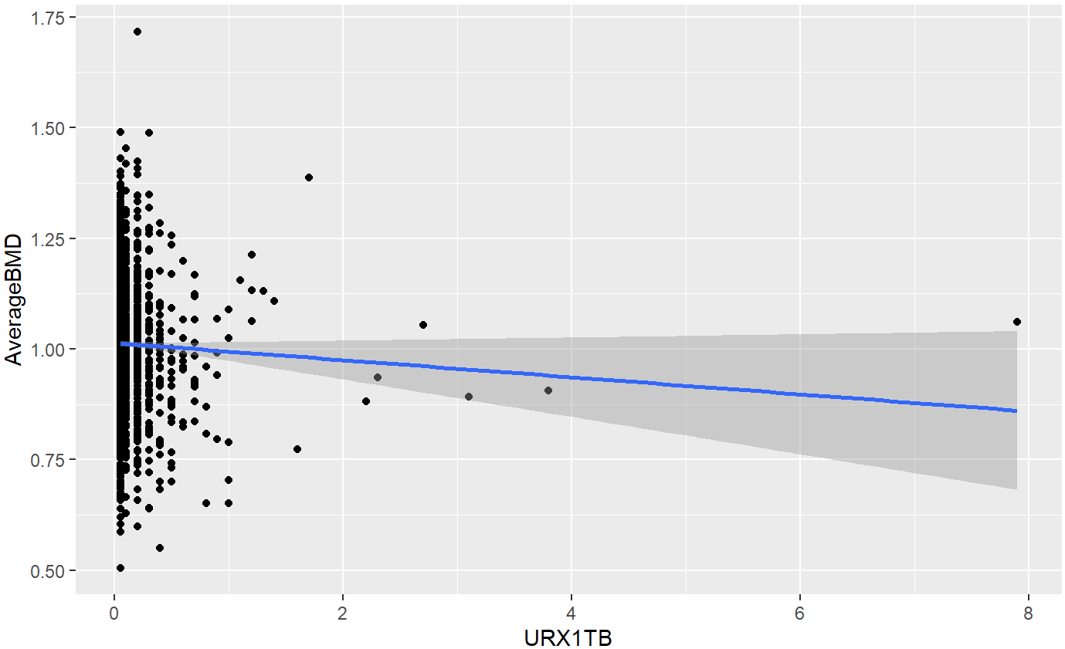
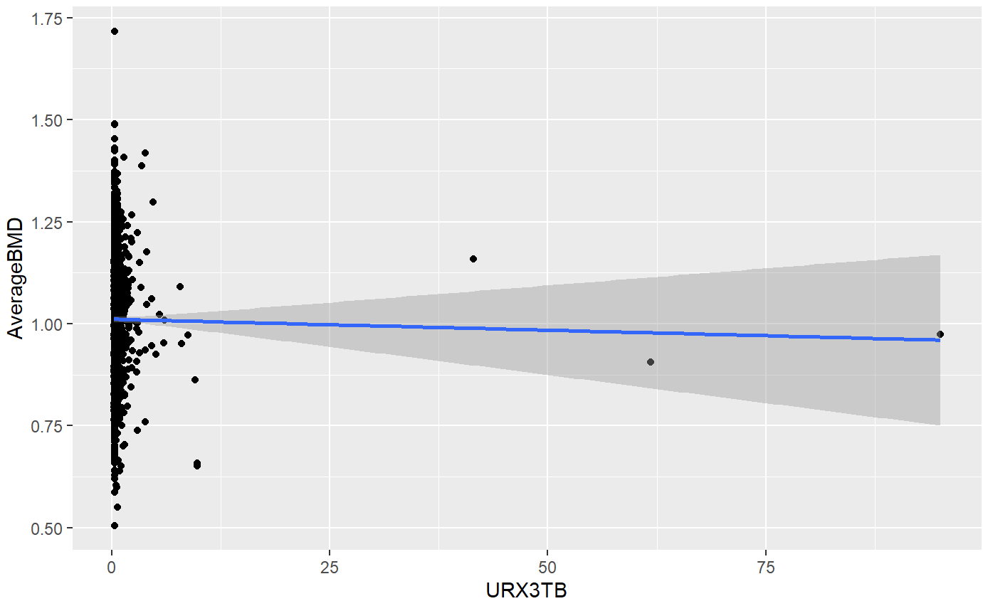
Scatter plots of raw predictors vs response (2)

Slide 11
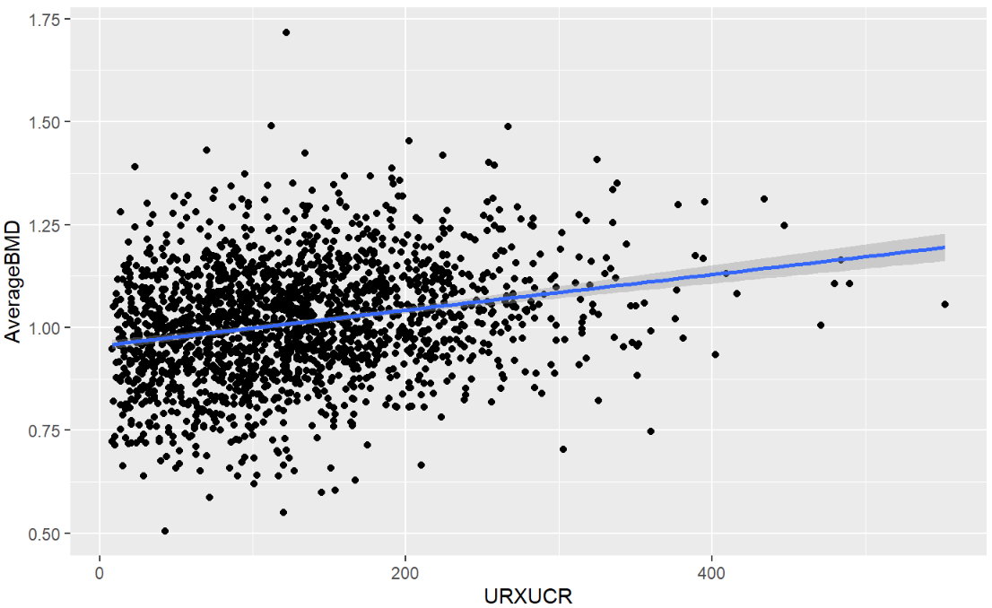
Scatter plots of raw predictors vs response (3)

Slide 12
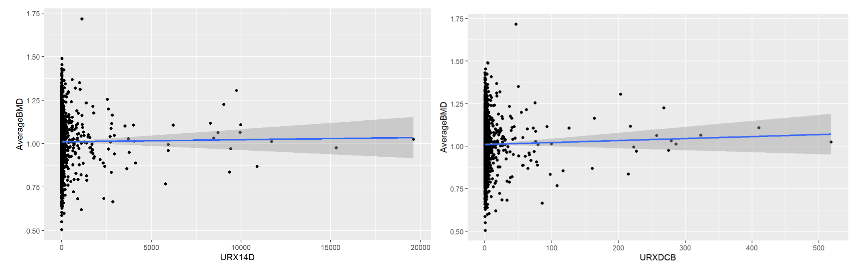
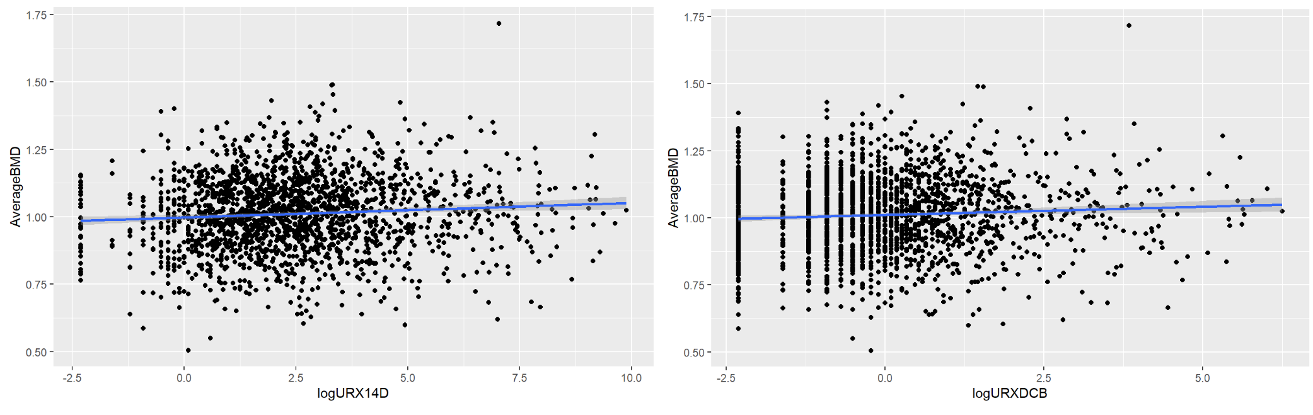
Log transformation of 5 pesticide variables

Slide 13
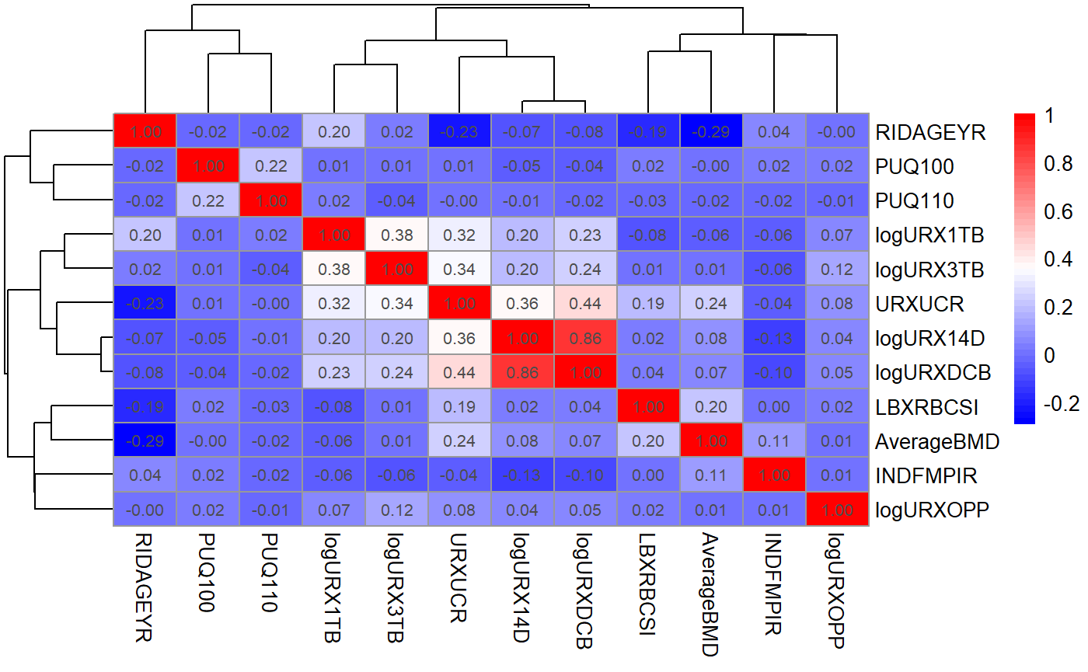
Correlation heatmap of variables

Slide 14
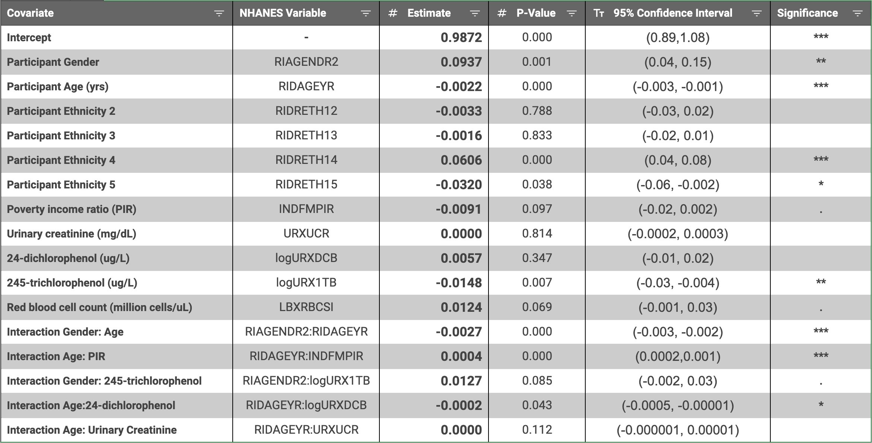
Final model determined by forward-backward stepwise selection

Slide 15
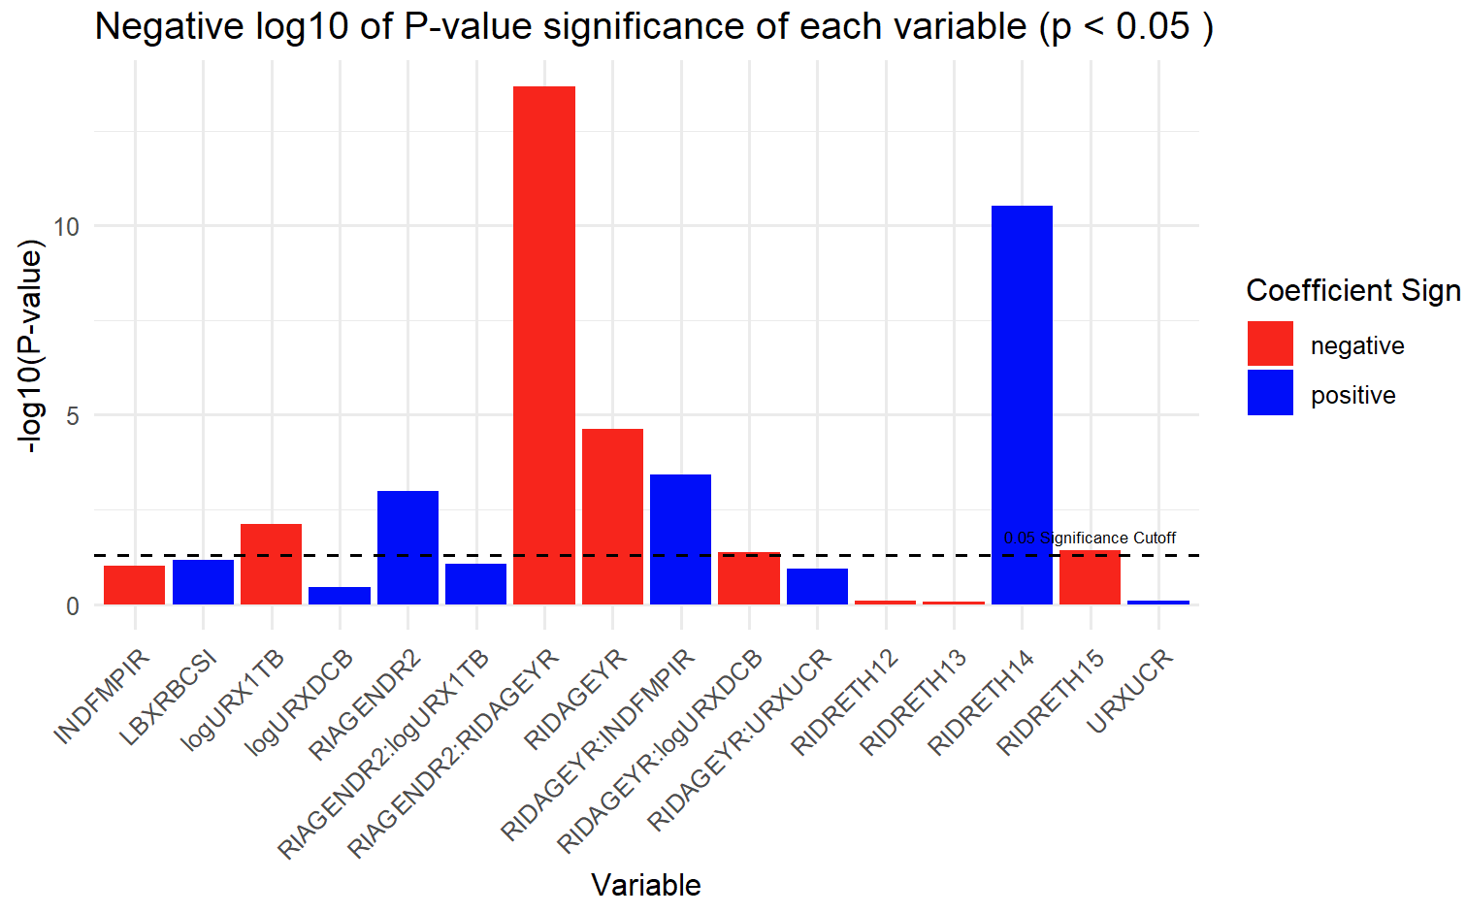
Significance of selected variables

Slide 16
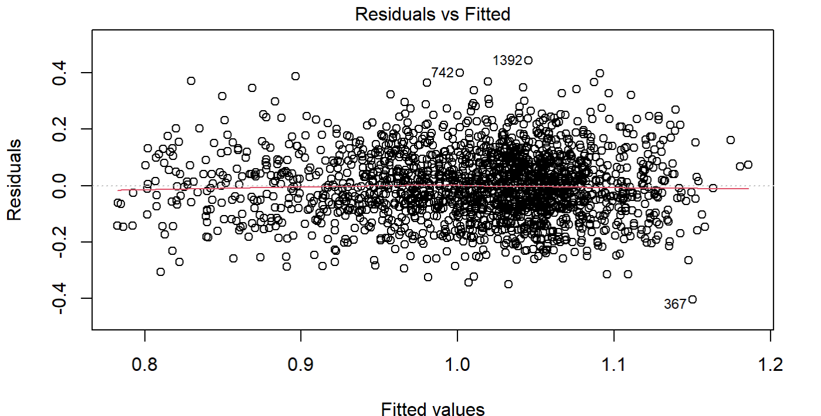
Model Diagnostics (1)

Slide 17
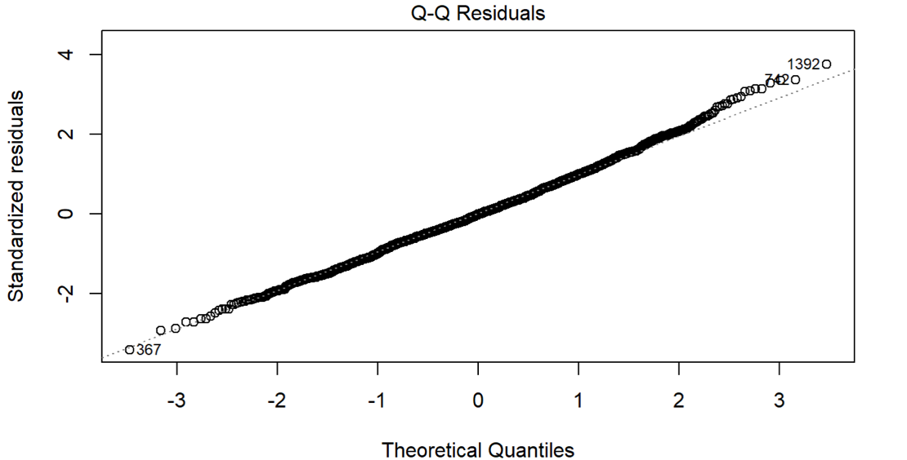
Model Diagnostics (2)

Slide 18
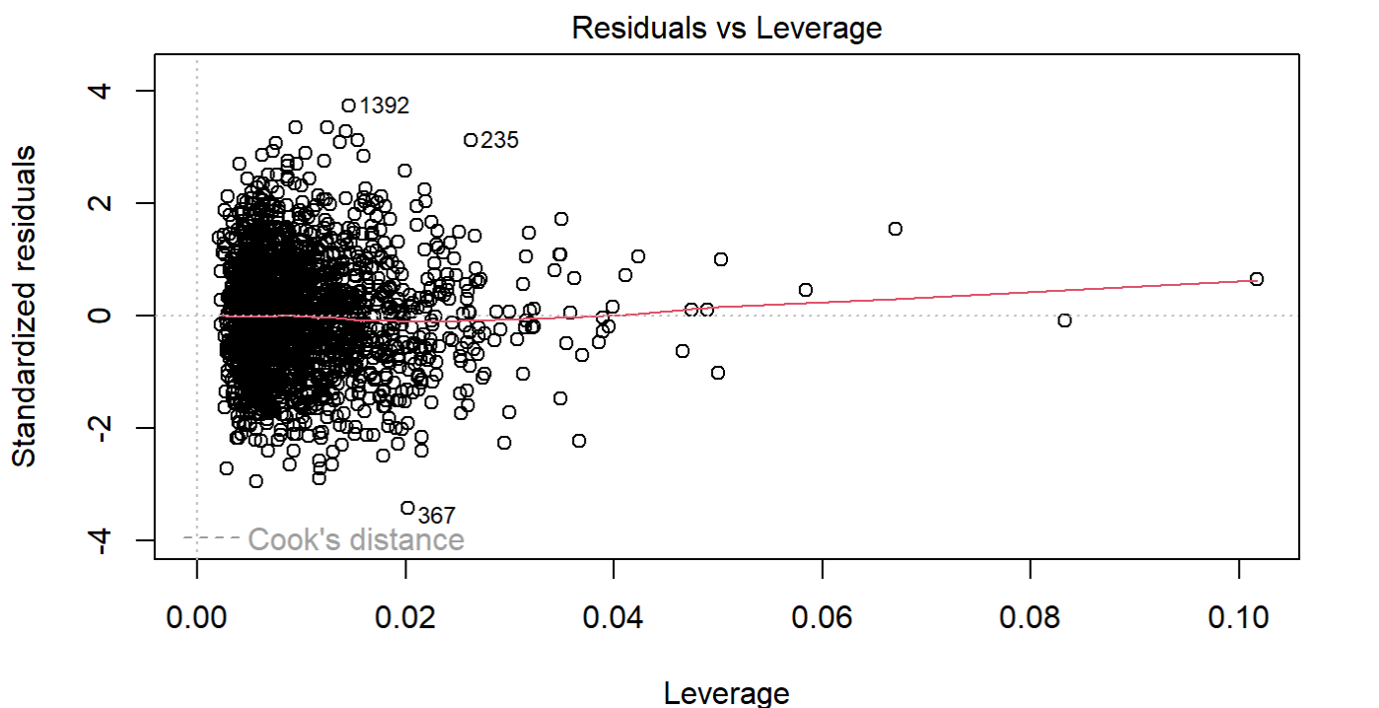
Model Diagnostics (3)

Slide 19
Final model determined by forward-backward stepwise selection

Slide 20
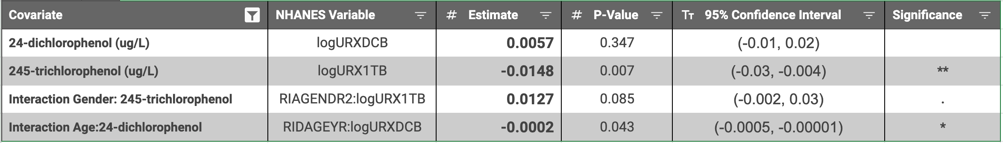
Statistical Inference
Model found only 1 pesticide with statistically significant associations with Average BMD: 245-trichlorophenol.
Accounting for the log transformation, a 1% increase in exposure to 245-trichlorophenol in the participant’s urine sample, is associated with a decrease in Average Bone Mineral Density of 0.000148 units.

Slide 21
Statistical Inference
Another interaction term that is significant at 0.1 confidence level was between GENDER2 and 245-trichlorophenol.
This term would imply that for a female participant, a 1% increase in exposure to 245-trichlorophenol is actually associated with an increase in Average BMD by 0.00013 units, offsetting the negative association that this pesticide has with males.
However, since our 95% confidence interval for this interaction terms contains 0, we refrain from drawing any confident conclusions about the effects of this pesticide.

Slide 22
Statistical Inference
The coefficient value of 24-dichlorophenol (URXDCB) did not represent a statistically significant association with Average BMD on its own.
Interaction term with Age of the participant (RIDAGEYR) is statistically significant at the 0.05 level. This implies that this pesticide does not have a constant effect on average BMD but rather, it varies depending on the age of the participant

Slide 23
Contextual Findings
Adjusted R2 on this final model was 0.258, suggesting that roughly 25% of the variance in the Average Bone Mineral Density of our dataset is explained by this final model.
However, our findings related to 245-trichlorophenol are in line with relevant literature like the study by Di. et. al. which studies the joint effects of Phenol Pesticides on BMD using the same NHANES dataset.
https://doi.org/10.1007/s11356-023-28065-z
https://pubmed.ncbi.nlm.nih.gov/36932377/
Our initial findings were more in line with literature as we found a significant association between 2,4 and 2,5 Dichlorophenol and Average BMD. However, multicollinearity issues prevented us from retaining these pesticides in our final model.

Slide 24
Suggestions and Improvements
Picked data from other years
Found data merge issue and limited the number of predictor variables we could look at
NHANES data limitations
Doesn’t provide temporal sequence of exposure and outcome
Is limited to a single timepoint survey
Other types of analysis
Ridge regression

